Slide 1
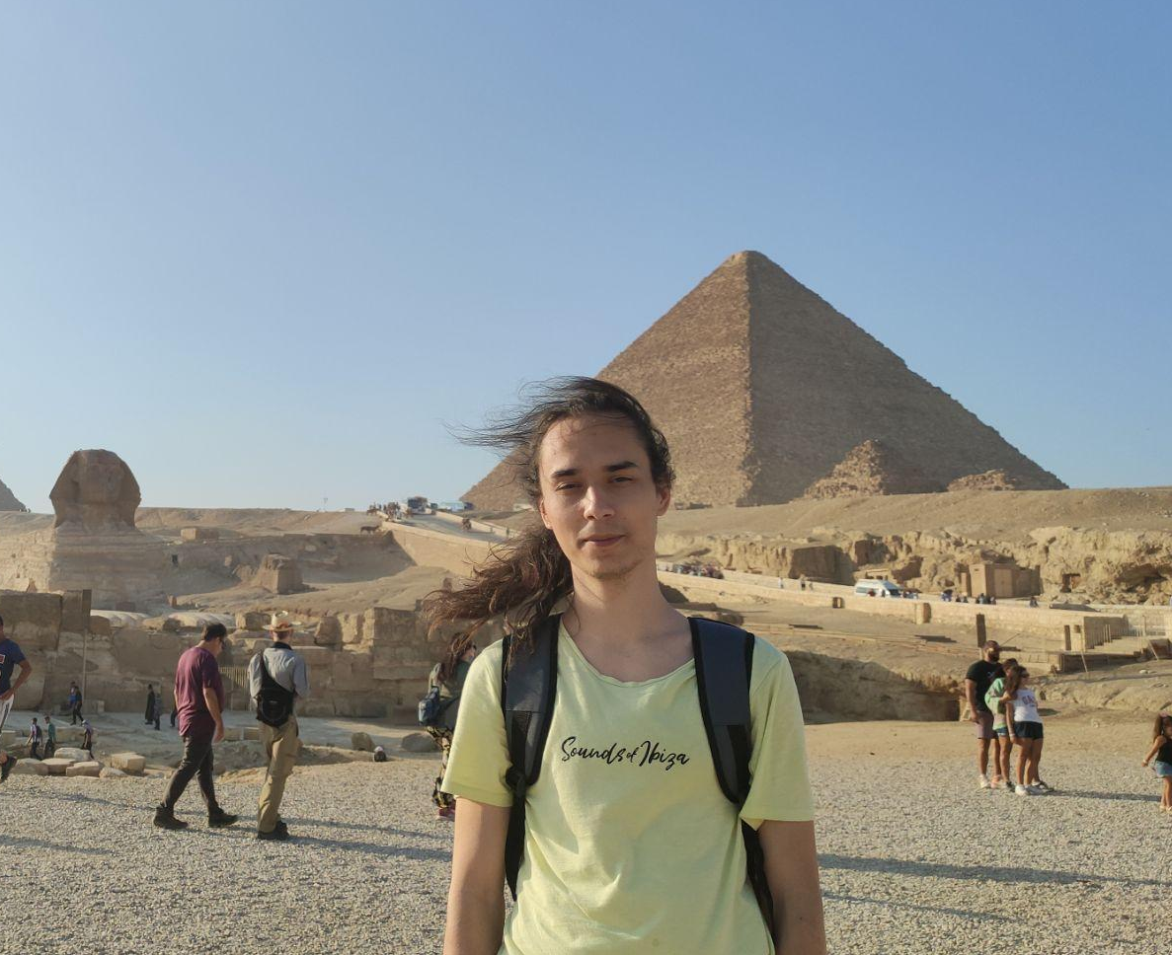
Mihai Valentin
Power IT
Team Lead
Backend Developer
Email: mihaivalentin373@gmail.com
GitHub: @mihai-valentin
Telegram: @mihai_valentin

Slide 2
WHAT’S UP?

Slide 3
Agile
SCRUM
My Vision*

Slide 4
PRINCIPLES
TRANSPARENCY
INSPECTION
ADAPTATION

Slide 5
COMMITMENT
VALUES
FOCUS
OPENNESS
RESPECT
COURAGE

Slide 6
THE GOAL
DEFINITION OF DONE

Slide 7
SCOPE
EPIC
STORY
TASK

Slide 8
SCRUM TEAM
Scrum Master
Product Owner
Developers

Slide 9
ARTIFACTS
PRODUCT BACKLOG
SPRINT BACKLOG
SPRINT BACKLOG
SPRINT BACKLOG

Slide 10
ESTIMATION
My Vision*

Slide 11
RETROSPECTIVE
EVENTS
SPRINT REVIEW
DAILY SCRUM
SPRINT PLANNING

Slide 12
ANALYZE

Slide 13
REPEAT

Slide 14
BUT …

Slide 15
QUESTIONS

Slide 16
THANK YOU!

Slide 17

LEARN MORE

Slide 18


